Slide 1
Remote User-Authentication Principles
The process of verifying an identity claimed by or for a system entity
An authentication process consists of two steps:
Identification step
Presenting an identifier to the security system
Verification step
Presenting or generating authentication information that corroborates the binding between the entity and the identifier
Notes:
For example, user Alice Toklas could have the user identifier ABTOKLAS.
This information needs to be stored on any server or computer system that
Alice wishes to use and could be known to system administrators and other
users. A typical item of authentication information associated with this user
ID is a password, which is kept secret (known only to Alice and to the system).
If no one is able to obtain or guess Alice’s password, then the combination of
Alice’s user ID and password enables administrators to set up Alice’s access permissions
and audit her activity. Because Alice’s ID is not secret, system users
can send her e-mail, but because her password is secret, no one can pretend to
be Alice.
In essence, identification is the means by which a user provides a claimed
identity to the system; user authentication is the means of establishing the validity
of the claim. Note that user authentication is distinct from message authentication.
As defined in Chapter 12, message authentication is a procedure that allows communicating
parties to verify that the contents of a received message have not been
altered and that the source is authentic. This chapter is concerned solely with user
authentication.

Slide 2
Means of User Authentication
For network-based user authentication, the most important methods involve cryptographic keys and something the individual knows, such as a password
There are four general means of authenticating a user’s identity, which can be used alone or in combination
Something the individual knows
Examples include a password, a personal identification number (PIN), or answers to a prearranged set of questions
Something the individual possesses
Examples include cryptographic keys, electronic keycards, smart cards, and physical keys
This is referred to as a token
Something the individual is (static biometrics)
Examples include recognition by fingerprint, retina, and face
Something the individual does (dynamic biometrics)
Examples include recognition by voice pattern, handwriting characteristics, and typing rhythm
Notes:
There are four general means of authenticating a user’s identity, which can be
used alone or in combination:
• Something the individual knows: Examples include a password, a personal
identification number (PIN), or answers to a prearranged set of questions.
• Something the individual possesses: Examples include cryptographic keys,
electronic keycards, smart cards, and physical keys. This type of authenticator
is referred to as a token .
• Something the individual is (static biometrics): Examples include recognition
by fingerprint, retina, and face.
• Something the individual does (dynamic biometrics): Examples include recognition
by voice pattern, handwriting characteristics, and typing rhythm.
All of these methods, properly implemented and used, can provide secure
user authentication. However, each method has problems. An adversary may be
able to guess or steal a password. Similarly, an adversary may be able to forge or
steal a token. A user may forget a password or lose a token. Furthermore, there is a
significant administrative overhead for managing password and token information
on systems and securing such information on systems. With respect to biometric authenticators,
there are a variety of problems, including dealing with false positives
and false negatives, user acceptance, cost, and convenience. For network-based user
authentication, the most important methods involve cryptographic keys and something
the individual knows, such as a password.

Slide 3
Mutual Authentication
Protocols which enable communicating parties to satisfy themselves mutually about each other’s identity and to exchange session keys
Central to the problem of authenticated key exchange are two issues:
Confidentiality
Essential identification and session-key information must be communicated in encrypted form
This requires the prior existence of secret or public keys that can be used for this purpose
Timeliness
Important because of the threat of message replays
Such replays could allow an opponent to:
successfully impersonate another party
disrupt operations by presenting parties with messages that appear genuine but are not
compromise a session key
Notes:
An important application area is that of mutual authentication protocols. Such
protocols enable communicating parties to satisfy themselves mutually about each
other’s identity and to exchange session keys. This topic was examined in Chapter 14.
There, the focus was key distribution. We return to this topic here to consider the
wider implications of authentication.
Central to the problem of authenticated key exchange are two issues: confidentiality
and timeliness. To prevent masquerade and to prevent compromise of session
keys, essential identification and session-key information must be communicated in encrypted
form. This requires the prior existence of secret or public keys that can be used
for this purpose. The second issue, timeliness, is important because of the threat of message
replays. Such replays, at worst, could allow an opponent to compromise a session
key or successfully impersonate another party. At minimum, a successful replay can
disrupt operations by presenting parties with messages that appear genuine but are not.

Slide 4
Replay Attacks
1. The simplest replay attack is one in which the opponent simply copies a message and replays it later
2. An opponent can replay a timestamped message within the valid time window
3. An opponent can replay a timestamped message within the valid time window, but in addition, the opponent suppresses the original message; thus, the repetition cannot be detected
4. Another attack involves a backward replay without modification and is possible if symmetric encryption is used and the sender cannot easily recognize the difference between messages sent and messages received on the basis of content (Reflection Attack)
Notes:
[GONG93] lists the following examples of replay attacks:
1. The simplest replay attack is one in which the opponent simply copies a
message and replays it later.
2. An opponent can replay a timestamped message within the valid time
window. If both the original and the replay arrive within then time window,
this incident can be logged.
3. As with example (2), an opponent can replay a timestamped message within
the valid time window, but in addition, the opponent suppresses the original
message. Thus, the repetition cannot be detected.
4. Another attack involves a backward replay without modification. This is a
replay back to the message sender. This attack is possible if symmetric encryption
is used and the sender cannot easily recognize the difference between
messages sent and messages received on the basis of content.

Slide 5
Approaches to Coping With Replay Attacks
Attach a sequence number to each message used in an authentication exchange
A new message is accepted only if its sequence number is in the proper order
Difficulty with this approach is that it requires each party to keep track of the last sequence number for each claimant it has dealt with
Generally not used for authentication and key exchange because of overhead
Timestamps
Requires that clocks among the various participants be synchronized
Party A accepts a message as fresh only if the message contains a timestamp that, in A’s judgment, is close enough to A’s knowledge of current time
Challenge/response
Party A, expecting a fresh message from B, first sends B a nonce (challenge) and requires that the subsequent message (response) received from B contain the correct nonce value
Binding – In all cases, cryptographic means must be used to insure that neither cut-and-paste nor message modification is possible without detection
Notes:
One approach to coping with replay attacks is to attach a sequence number to
each message used in an authentication exchange. A new message is accepted only if
its sequence number is in the proper order. The difficulty with this approach is that
it requires each party to keep track of the last sequence number for each claimant it
has dealt with. Because of this overhead, sequence numbers are generally not used
for authentication and key exchange. Instead, one of the following two general approaches
is used:
• Timestamps: Party A accepts a message as fresh only if the message contains a
timestamp that, in A’s judgment, is close enough to A’s knowledge of current
time. This approach requires that clocks among the various participants be
synchronized.
• Challenge/response: Party A, expecting a fresh message from B, first sends
B a nonce (challenge) and requires that the subsequent message (response)
received from B contain the correct nonce value.
It can be argued (e.g., [LAM92a]) that the timestamp approach should not be
used for connection-oriented applications because of the inherent difficulties with this
technique. First, some sort of protocol is needed to maintain synchronization among
the various processor clocks. This protocol must be both fault tolerant, to cope with
network errors, and secure, to cope with hostile attacks. Second, the opportunity for
a successful attack will arise if there is a temporary loss of synchronization resulting
from a fault in the clock mechanism of one of the parties. Finally, because of the
variable and unpredictable nature of network delays, distributed clocks cannot be
expected to maintain precise synchronization. Therefore, any timestamp-based procedure
must allow for a window of time sufficiently large to accommodate network
delays yet sufficiently small to minimize the opportunity for attack.
On the other hand, the challenge-response approach is unsuitable for a connectionless
type of application, because it requires the overhead of a handshake before
any connectionless transmission, effectively negating the chief characteristic of
a connectionless transaction. For such applications, reliance on some sort of secure
time server and a consistent attempt by each party to keep its clocks in synchronization
may be the best approach (e.g., [LAM92b]).

Slide 6
One-Way Authentication
One application for which encryption is growing in popularity is electronic mail (e-mail)
Header of the e-mail message must be in the clear so that the message can be handled by the store-and-forward e-mail protocol, such as SMTP or X.400
The e-mail message should be encrypted such that the mail-handling system is not in possession of the decryption key
A second requirement is that of authentication
The recipient wants some assurance that the message is from the alleged sender
See Chapter 19 on securing email
Notes:
One application for which encryption is growing in popularity is electronic mail
(e-mail). The very nature of electronic mail, and its chief benefit, is that it is not necessary
for the sender and receiver to be online at the same time. Instead, the e-mail
message is forwarded to the receiver’s electronic mailbox, where it is buffered until
the receiver is available to read it.
The “envelope” or header of the e-mail message must be in the clear, so that
the message can be handled by the store-and-forward e-mail protocol, such as the
Simple Mail Transfer Protocol (SMTP) or X.400. However, it is often desirable that
the mail-handling protocol not require access to the plaintext form of the message,
because that would require trusting the mail-handling mechanism. Accordingly, the
e-mail message should be encrypted such that the mail-handling system is not in
possession of the decryption key.
A second requirement is that of authentication . Typically, the recipient wants
some assurance that the message is from the alleged sender.

Slide 7
Remote User-Authentication Using Symmetric Encryption
A two-level hierarchy of symmetric keys can be used to provide confidentiality for communication in a distributed environment
Strategy involves the use of a trusted key distribution center (KDC)
Each party shares a secret key, known as a master key, with the KDC
KDC is responsible for generating keys to be used for a short time over a connection between two parties and for distributing those keys using the master keys to protect the distribution
Notes:
As was discussed in Chapter 14, a two-level hierarchy of symmetric encryption keys
can be used to provide confidentiality for communication in a distributed environment.
In general, this strategy involves the use of a trusted key distribution center
(KDC). Each party in the network shares a secret key, known as a master key, with
the KDC. The KDC is responsible for generating keys to be used for a short time
over a connection between two parties, known as session keys, and for distributing
those keys using the master keys to protect the distribution. This approach is quite
common. As an example, we look at the Kerberos system in Section 15.3. The discussion
in this subsection is relevant to an understanding of the Kerberos mechanisms.

Slide 8
Suppress-Replay Attacks
The Denning protocol requires reliance on clocks that are synchronized throughout the network
A risk involved is based on the fact that the distributed clocks can become unsynchronized as a result of sabotage on or faults in the clocks or the synchronization mechanism
The problem occurs when a sender’s clock is ahead of the intended recipient’s clock
An opponent can intercept a message from the sender and replay it later when the timestamp in the message becomes current at the recipient’s site
Such attacks are referred to as suppress-replay attacks
Notes:
The Denning protocol seems to provide an increased degree of security compared
to the Needham/Schroeder protocol. However, a new concern is raised:
namely, that this new scheme requires reliance on clocks that are synchronized
throughout the network. [GONG92] points out a risk involved. The risk is based
on the fact that the distributed clocks can become unsynchronized as a result of
sabotage on or faults in the clocks or the synchronization mechanism.2 The problem
occurs when a sender’s clock is ahead of the intended recipient’s clock. In this case,
an opponent can intercept a message from the sender and replay it later when the
timestamp in the message becomes current at the recipient’s site. This replay could
cause unexpected results. Gong refers to such attacks as suppress-replay attacks .
One way to counter suppress-replay attacks is to enforce the requirement that
parties regularly check their clocks against the KDC’s clock. The other alternative,
which avoids the need for clock synchronization, is to rely on handshaking protocols
using nonces. This latter alternative is not vulnerable to a suppress-replay attack,
because the nonces the recipient will choose in the future are unpredictable to the
sender. The Needham/Schroeder protocol relies on nonces only but, as we have
seen, has other vulnerabilities.

Slide 9
Mutual Authentication
Public-key encryption for session key distribution
Assumes each of the two parties is in possession of the current public key of the other
May not be practical to require this assumption
Denning protocol using timestamps
Uses an authentication server (AS) to provide public-key certificates
Requires the synchronization of clocks
Woo and Lam makes use of nonces
Care needed to ensure no protocol flaws
Notes:
In Chapter 14, we presented one approach to the use of public-key encryption for
the purpose of session-key distribution (Figure 14.9). This protocol assumes that
each of the two parties is in possession of the current public key of the other. It may
not be practical to require this assumption.
A protocol using timestamps is provided in [DENN81]
In this case, the central system is referred to as an authentication server (AS),
because it is not actually responsible for secret-key distribution. Rather, the AS provides
public-key certificates. The session key is chosen and encrypted by A; hence,
there is no risk of exposure by the AS. The timestamps protect against replays of
compromised keys.
This protocol is compact but, as before, requires the synchronization of clocks.
Another approach, proposed by Woo and Lam [WOO92a], makes use of nonces.
This seems to be a secure protocol that takes into account the various attacks.
However, the authors themselves spotted a flaw and submitted a revised version of
the algorithm.
In both this example and the protocols described earlier, protocols that appeared
secure were revised after additional analysis. These examples highlight the
difficulty of getting things right in the area of authentication.

Slide 10
One-Way Authentication
Have public-key approaches for e-mail
Encryption of message for confidentiality, authentication, or both
The public-key algorithm must be applied once or twice to what may be a long message
For confidentiality encrypt message with one-time secret key, public-key encrypted
If authentication is the primary concern, a digital signature may suffice
Notes:
We have already presented public-key encryption approaches that are suited to electronic mail, including the straightforward encryption of the entire message for confidentiality (Figure 12.1b), authentication (Figure 12.1c), or both (Figure 12.1d). These approaches require that either the sender know the recipient's public key (confidentiality) or the recipient know the sender's public key (authentication) or both (confidentiality plus authentication). In addition, the public-key algorithm must be applied once or twice to what may be a long message.
If confidentiality is the primary concern, then better to encrypt the message with a one-time secret key, and also encrypt this one-time key with B's public key. If authentication is the primary concern, then a digital signature may suffice (but could be replaced by an opponent). To counter such a scheme, both the message and signature can be encrypted with the recipient's public key. The latter two schemes require that B know A's public key and be convinced that it is timely. An effective way to provide this assurance is the digital certificate.
If authentication is the primary concern, then a digital signature may suffice.

Slide 11
Federated Identity Management
Relatively new concept dealing with the use of a common identity management scheme across multiple enterprise and numerous applications and supporting many users
Services provided include:
Point of contact
SSO protocol services
Trust services
Key services
Identity services
Authorization
Provisioning
Management
Notes:
Federated identity management is a relatively new concept dealing with the use of
a common identity management scheme across multiple enterprises and numerous
applications and supporting many thousands, even millions, of users. We begin our
overview with a discussion of the concept of identity management and then examine
federated identity management.
Typical services provided by a federated identity management system include
the following:
• Point of contact: Includes authentication that a user corresponds to the user
name provided, and management of user/server sessions.
• SSO protocol services: Provides a vendor-neutral security token service for
supporting a single sign on to federated services.
• Trust services: Federation relationships require a trust relationship-based
federation between business partners. A trust relationship is represented by
the combination of the security tokens used to exchange information about a
user, the cryptographic information used to protect these security tokens, and
optionally the identity mapping rules applied to the information contained
within this token.
• Key services: Management of keys and certificates.
• Identity services: services that provide the interface to local data stores,
including user registries and databases, for identity-related information
management.
• Authorization: Granting access to specific services and/or resources based on
the authentication.
• Provisioning: Includes creating an account in each target system for the user,
enrollment or registration of user in accounts, establishment of access rights or
credentials to ensure the privacy and integrity of account data.
• Management: Services related to runtime configuration and deployment.

Slide 12
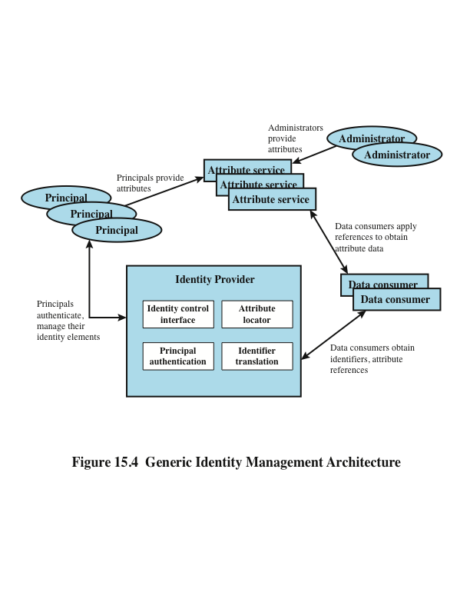
Notes:
Figure 15.4 illustrates entities and data flows in a generic identity management
architecture. A principal is an identity holder. Typically, this is a human user
that seeks access to resources and services on the network. User devices, agent processes,
and server systems may also function as principals. Principals authenticate
themselves to an identity provider . The identity provider associates authentication
information with a principal, as well as attributes and one or more identifiers.
Increasingly, digital identities incorporate attributes other than simply
an identifier and authentication information (such as passwords and biometric
information). An attribute service manages the creation and maintenance of such
attributes. For example, a user needs to provide a shipping address each time an
order is placed at a new Web merchant, and this information needs to be revised
when the user moves. Identity management enables the user to provide this information
once, so that it is maintained in a single place and released to data consumers
in accordance with authorization and privacy policies. Users may create some
of the attributes to be associated with their digital identity, such as an address.
Administrators may also assign attributes to users, such as roles, access permissions,
and employee information.
Data consumers are entities that obtain and employ data maintained and
provided by identity and attribute providers, which are often used to support authorization
decisions and to collect audit information. For example, a database server
or file server is a data consumer that needs a client’s credentials so as to know what
access to provide to that client.

Slide 13
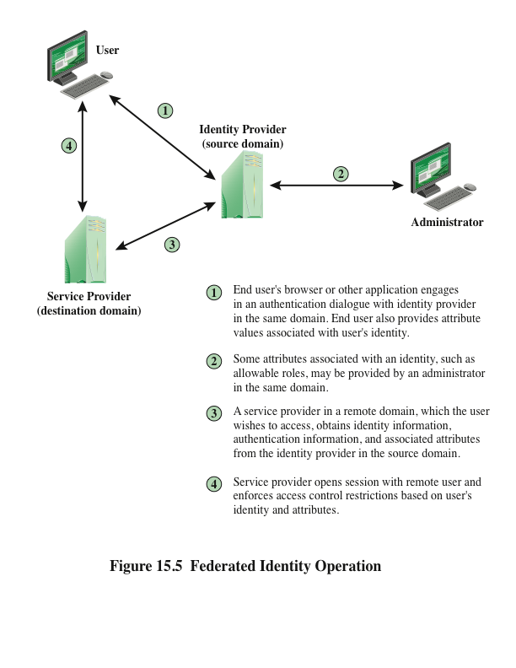
Notes:
Identity federation is, in essence, an extension of identity management to
multiple security domains. Such domains include autonomous internal business
units, external business partners, and other third-party applications and services.
The goal is to provide the sharing of digital identities so that a user can be authenticated
a single time and then access applications and resources across multiple
domains. Because these domains are relatively autonomous or independent, no
centralized control is possible. Rather, the cooperating organizations must form a
federation based on agreed standards and mutual levels of trust to securely share
digital identities.
Federated identity management refers to the agreements, standards, and
technologies that enable the portability of identities, identity attributes, and entitlements
across multiple enterprises and numerous applications and supporting many
thousands, even millions, of users. When multiple organizations implement interoperable
federated identity schemes, an employee in one organization can use a single
sign-on to access services across the federation with trust relationships associated
with the identity. For example, an employee may log onto her corporate intranet
and be authenticated to perform authorized functions and access authorized services
on that intranet. The employee could then access their health benefits from an
outside health-care provider without having to re-authenticate.
Beyond SSO, federated identity management provides other capabilities. One
is a standardized means of representing attributes. Increasingly, digital identities
incorporate attributes other than simply an identifier and authentication information
(such as passwords and biometric information). Examples of attributes include
account numbers, organizational roles, physical location, and file ownership. A user
may have multiple identifiers; for example, each identifier may be associated with a
unique role with its own access permissions.
Another key function of federated identity management is identity mapping.
Different security domains may represent identities and attributes differently.
Further, the amount of information associated with an individual in one domain
may be more than is necessary in another domain. The federated identity management
protocols map identities and attributes of a user in one domain to the requirements
of another domain.
Figure 15.5 illustrates entities and data flows in a generic federated identity
management architecture.
The identity provider acquires attribute information through dialogue and
protocol exchanges with users and administrators. For example, a user needs to
provide a shipping address each time an order is placed at a new Web merchant,
and this information needs to be revised when the user moves. Identity management
enables the user to provide this information once, so that it is maintained in
a single place and released to data consumers in accordance with authorization
and privacy policies.
Service providers are entities that obtain and employ data maintained and
provided by identity providers, often to support authorization decisions and to
collect audit information. For example, a database server or file server is a data
consumer that needs a client’s credentials so as to know what access to provide to
that client. A service provider can be in the same domain as the user and the identity
provider. The power of this approach is for federated identity management,
in which the service provider is in a different domain (e.g., a vendor or supplier
network).

Slide 14
Key Standards
The Extensible Markup Language (XML)
A markup language that uses sets of embedded tags or labels to characterize text elements within a document so as to indicate their appearance, function, meaning, or context
The Simple Object Access Protocol (SOAP)
Enables applications to request services from one another with XML-based requests and receive responses as data formatted with XML
WS-Security
A set of SOAP extensions for implementing message integrity and confidentiality in Web services
Security Assertion Markup Language (SAML)
An XML-based language for the exchange of security information between online business partners
Notes:
Federated identity management uses a number of standards as the
building blocks for secure identity exchange across different domains or heterogeneous
systems. In essence, organizations issue some form of security tickets for their
users that can be processed by cooperating partners. Identity federation standards
are thus concerned with defining these tickets, in terms of content and format, providing
protocols for exchanging tickets and performing a number of management
tasks. These tasks include configuring systems to perform attribute transfers and
identity mapping, and performing logging and auditing functions. The key standards
are as follows:
• The Extensible Markup Language (XML): A markup language that uses sets
of embedded tags or labels to characterize text elements within a document
so as to indicate their appearance, function, meaning, or context. XML documents
appear similar to HTML (Hypertext Markup Language) documents
that are visible as Web pages, but provide greater functionality. XML includes
strict definitions of the data type of each field, thus supporting database formats
and semantics. XML provides encoding rules for commands that are
used to transfer and update data objects.
• The Simple Object Access Protocol (SOAP): A minimal set of conventions
for invoking code using XML over HTTP. It enables applications to request
services from one another with XML-based requests and receive responses
as data formatted with XML. Thus, XML defines data objects and structures,
and SOAP provides a means of exchanging such data objects and performing
remote procedure calls related to these objects. See [ROS06] for an informative
discussion.
• WS-Security: A set of SOAP extensions for implementing message integrity
and confidentiality in Web services. To provide for secure exchange of SOAP
messages among applications, WS-Security assigns security tokens to each
message for use in authentication.
• Security Assertion Markup Language (SAML): An XML-based language
for the exchange of security information between online business partners.
SAML conveys authentication information in the form of assertions about
subjects. Assertions are statements about the subject issued by an authoritative
entity.
The challenge with federated identity management is to integrate multiple
technologies, standards, and services to provide a secure, user-friendly utility. The
key, as in most areas of security and networking, is the reliance on a few mature
standards widely accepted by industry. Federated identity management seems to
have reached this level of maturity.

Slide 15
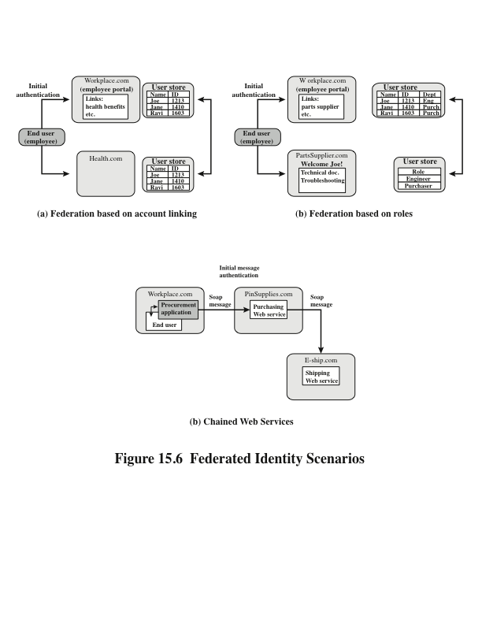
Notes:
To get some feel for the functionality of identity federation, we look at three scenarios, taken from [COMP06]
In the first (Figure 15.5a), Workplace.com contracts with Health.com to provide employee health benefits. An employee signs on and authenticates to Workplace.com. The two organizations federated and cooperatively exchanges user identifiers. Health.com maintains user identities for every employee at Workplace.com and associates with each identity health benefits info & access rights.
Figure 15.5b shows another browser-based scheme. PartsSupplier.com is a regular supplier of parts to Workplace.com. A role-based access control (RBAC) scheme is used. An engineer of Workplace.com authenticates to Workplace.com and clicks on a link to access information at PartsSupplier.com. For this scenario, PartSupplier.com does not have identity information for individual employees at Workplace.com. Rather, the linkage between the two federated partners is in terms of roles.
The scenario in Figure 15.5c can be referred to as document-based. Workplace.com has a purchasing agreement with PinSupplies.com which has a business relationship with E-Ship.com. An employee of WorkPlace.com signs on and is authenticated to make purchases. The procurement application generates an XML/SOAP order document, and inserts into the header the user's credentials and Workplace.com's organizational identity. It then posts the message to the PinSupplies.com's purchasing Web service. This service authenticates the incoming message and processes the request, sending a SOAP message to its shipping partner to fulfill the order.

Slide 16
Personal Identity Verification
User authentication based on the possession of a smart card is becoming more widespread
Has the appearance of a credit card
Has an electronic interface
May use a variety of authentication protocols
A smart card contains within it an entire microprocessor, including processor, memory, and I/O ports
A smart card includes three types of memory:
Read-only memory (ROM) stores data that does not change during the card’s life
Electronically erasable programmable ROM (EEPROM) holds application data and programs; also holds data that may vary with time
Random access memory (RAM) holds temporary data generated when applications are executed
Notes:
User authentication based on the possession of a smart card is becoming more widespread.
A smart card has the appearance of a credit card, has an electronic interface,
and may use a variety of authentication protocols.
A smart card contains within it an entire microprocessor, including processor,
memory, and I/O ports. Some versions incorporate a special co-processing circuit
for cryptographic operation to speed the task of encoding and decoding messages or
generating digital signatures to validate the information transferred. In some cards,
the I/O ports are directly accessible by a compatible reader by means of exposed
electrical contacts. Other cards rely instead on an embedded antenna for wireless
communication with the reader.
A typical smart card includes three types of memory. Read-only memory
(ROM) stores data that does not change during the card’s life, such as the card
number and the cardholder’s name. Electrically erasable programmable ROM
(EEPROM) holds application data and programs, such as the protocols that the
card can execute. It also holds data that may vary with time. For example, in a telephone
card, the EEPROM holds the talk time remaining. Random access memory
(RAM) holds temporary data generated when applications are executed.
For the practical application of smart card authentication, a wide range of
vendors must conform to standards that cover smart card protocols, authentication
and access control formats and protocols, database entries, message formats, and so
on. An important step in this direction is FIPS 201-2 (Personal Identity Verification
[PIV] of Federal Employees and Contractors , June 2012). The standard defines a
reliable, government-wide PIV system for use in applications such as access to federally
controlled facilities and information systems. The standard specifies a PIV
system within which common identification credentials can be created and later
used to verify a claimed identity. The standard also identifies Federal government-wide
requirements for security levels that are dependent on risks to the facility or
information being protected. The standard applies to private-sector contractors as
well, and serves as a useful guideline for any organization.

Slide 17
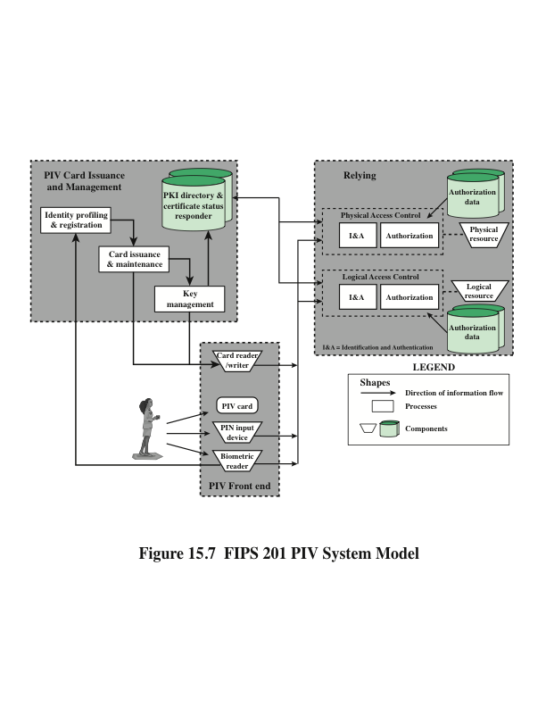
Notes:
Figure 15.7 illustrates the major components of FIPS 201-2 compliant systems. The
PIV front end defines the physical interface to a user who is requesting access to a
facility, which could be either physical access to a protected physical area or logical
access to an information system. The PIV front-end subsystem supports up to
three-factor authentication; the number of factors used depends on the level of security
required. The front end makes use of a smart card, known as a PIV card,
which is a dual-interface contact and contactless card. The card holds a cardholder
photograph, X.509 certificates, cryptographic keys, biometric data, and a cardholder
unique identifier (CHUID). Certain cardholder information may be read-protected
and require a personal identification number (PIN) for read access by the card
reader. The biometric reader, in the current version of the standard, is a fingerprint
reader or an iris scanner.
The standard defines three assurance levels for verification of the card and the
encoded data stored on the card, which in turn leads to verifying the authenticity of
the person holding the credential. A level of some confidence corresponds to use of
the card reader and PIN. A level of high confidence adds a biometric comparison
of a fingerprint captured and encoded on the card during the card-issuing process
and a fingerprint scanned at the physical access point. A very high confidence level
requires that the process just described is completed at a control point attended by
an official observer.
The other major component of the PIV system is the PIV card issuance and
management subsystem . This subsystem includes the components responsible for
identity proofing and registration, card and key issuance and management, and the
various repositories and services (e.g., public key infrastructure [PKI] directory, certificate
status servers) required as part of the verification infrastructure.
The PIV system interacts with a relying subsystem , which includes components
responsible for determining a particular PIV cardholder’s access to a physical
or logical resource. FIPS 201-2 standardizes data formats and protocols for interaction
between the PIV system and the relying system.
Unlike the typical card number/facility code encoded on most access control
cards, the FIPS 201 CHUID takes authentication to a new level, through the use of
an expiration date (a required CHUID data field) and an optional CHUID digital signature.
A digital signature can be checked to ensure that the CHUID recorded on the
card was digitally signed by a trusted source and that the CHUID data have not been
altered since the card was signed. The CHUID expiration date can be checked to verify
that the card has not expired. This is independent from whatever expiration date is associated
with cardholder privileges. Reading and verifying the CHUID alone provides
only some assurance of identity because it authenticates the card data, not the cardholder.
The PIN and biometric factors provide identity verification of the individual.

Slide 18
PIV Documentation
FIPS 201-2—Personal Identity Verification (PIV) of Federal Employees and Contractors
Specifies the physical card characteristics, storage media, and data elements that make up the identity credentials resident on the PIV card
SP 800-73-3—Interfaces for Personal Identity Verification
Specifies the interfaces and card architecture for storing and retrieving identity credentials from a smart card, and provides guidelines for the use of authentication mechanisms and protocols
SP 800-76-2—Biometric Data Specification for Personal Identity Verification
Describes technical acquisition and formatting specifications for the biometric credentials of the PIV system
SP 800-78-3—Cryptographic Algorithms and Key Sizes for Personal Identity Verification
Identifies acceptable symmetric and asymmetric encryption algorithms, digital signature algorithms, and message digest algorithms, and specifies mechanisms to identify the algorithms associated with PIV keys or digital signatures
SP 800-104—A Scheme for PIV Visual Card Topography
Provides additional recommendations on the PIV card color-coding for designating employee affiliation
SP 800-116—A Recommendation for the Use of PIV Credentials in Physical Access Control Systems (PACS)
Describes a risk-based approach for selecting appropriate PIV authentication mechanisms to manage physical access to Federal government facilities and assets
SP 800-79-1—Guidelines for the Accreditation of Personal Identity Verification Card Issuers
Provides guidelines for accrediting the reliability of issuers of PIV cards that collect, store, and disseminate personal identity credentials and issue smart cards
SP 800-96—PIV Card to Reader Interoperability Guidelines
Provides requirements that facilitate interoperability between any card and any reader
Notes:
The PIV specification is quite complex, and NIST has issued a number of documents
that cover a broad range of PIV topics. These are as follows:
• FIPS 201-2—Personal Identity Verification (PIV) of Federal Employees
and Contractors: Specifies the physical card characteristics, storage media,
and data elements that make up the identity credentials resident on the
PIV card.
• SP 800-73-3—Interfaces for Personal Identity Verification: Specifies the interfaces
and card architecture for storing and retrieving identity credentials from
a smart card, and provides guidelines for the use of authentication mechanisms
and protocols.
• SP 800-76-2—Biometric Data Specification for Personal Identity Verification:
Describes technical acquisition and formatting specifications for the biometric
credentials of the PIV system.
• SP 800-78-3—Cryptographic Algorithms and Key Sizes for Personal Identity
Verification: Identifies acceptable symmetric and asymmetric encryption
algorithms, digital signature algorithms, and message digest algorithms, and
specifies mechanisms to identify the algorithms associated with PIV keys or
digital signatures.
• SP 800-104—A Scheme for PIV Visual Card Topography: Provides additional
recommendations on the PIV card color-coding for designating employee
affiliation.
• SP 800-116—A Recommendation for the Use of PIV Credentials in Physical
Access Control Systems (PACS): Describes a risk-based approach for selecting
appropriate PIV authentication mechanisms to manage physical access to
Federal government facilities and assets.
• SP 800-79-1—Guidelines for the Accreditation of Personal Identity
Verification Card Issuers: Provides guidelines for accrediting the reliability
of issuers of PIV cards that collect, store, and disseminate personal identity
credentials and issue smart cards.
• SP 800-96—PIV Card to Reader Interoperability Guidelines: Provides
requirements that facilitate interoperability between any card and any
reader.

Slide 19
PIV Credentials and Keys
Personal Identification Number (PIN)
Required to activate the card for privileged operation
Cardholder Unique Identifier (CHUID)
Includes the Federal Agency Smart Credential Number (FASC-N) and the Global Unique Identification Number (GUID), which uniquely identify the card and the cardholder
PIV Authentication Key
Asymmetric key pair and corresponding certificate for user authentication
Two fingerprint templates
For biometric authentication
Electronic facial image
For biometric authentication
Asymmetric Card Authentication Key
Asymmetric key pair and corresponding certificate used for card authentication
Optional elements include the following:
Digital Signature Key
Asymmetric key pair and corresponding certificate that supports document signing and signing of data elements such as the CHUID
Key Management Key
Asymmetric key pair and corresponding certificate supporting key establishment and transport
Symmetric Card Authentication Key
For supporting physical access applications
PIV Card Application Administration Key
Symmetric key associated with the card management system
One or two iris images
For biometric authentication
Notes:
The PIV card contains a number of mandatory and optional data elements that
serve as identity credentials with varying levels of strength and assurance. These
credentials are used singly or in sets to authenticate the holder of the PIV card to
achieve the level of assurance required for a particular activity or transaction. The
mandatory data elements are the following:
• Personal Identification Number (PIN): Required to activate the card for privileged
operation.
• Cardholder Unique Identifier (CHUID): Includes the Federal Agency Smart
Credential Number (FASC-N) and the Global Unique Identification Number
(GUID), which uniquely identify the card and the cardholder.
• PIV Authentication Key: Asymmetric key pair and corresponding certificate
for user authentication.
• Two fingerprint templates: For biometric authentication.
• Electronic facial image: For biometric authentication.
• Asymmetric Card Authentication Key: Asymmetric key pair and corresponding
certificate used for card authentication.
Optional elements include the following:
• Digital Signature Key: Asymmetric key pair and corresponding certificate
that supports document signing and signing of data elements such as the
CHUID.
• Key Management Key: Asymmetric key pair and corresponding certificate
supporting key establishment and transport.
• Symmetric Card Authentication Key: For supporting physical access
applications.
• PIV Card Application Administration Key: Symmetric key associated with
the card management system.
• One or two iris images: For biometric authentication.

Slide 20
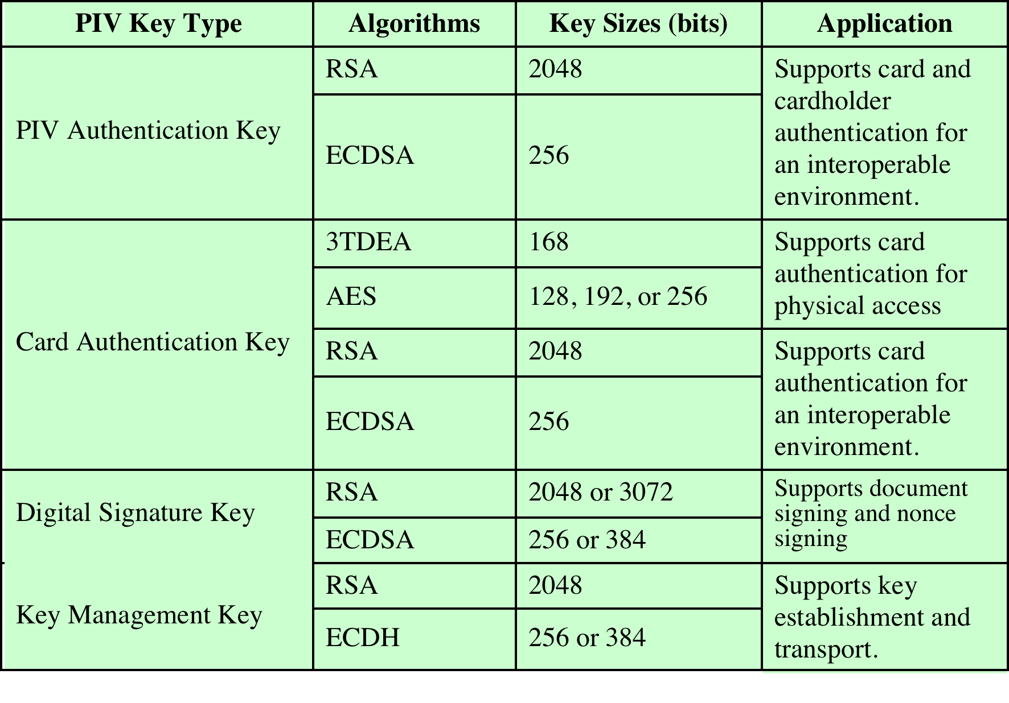
Table 15.5
PIV Algorithms and Key Sizes
Notes:
Table 15.5 lists the algorithm and key size requirements for PIV key types.

Slide 21
Authentication
Using the electronic credentials resident on a PIV card, the card supports the following authentication mechanisms:
CHUID
The cardholder is authenticated using the signed CHUID data element on the card. The PIN is not required. This mechanism is useful in environments where a low level of assurance is acceptable and rapid contactless authentication is necessary
Card Authentication Key
The PIV card is authenticated using the Card Authentication Key in a challenge response protocol. The PIN is not required. This mechanism allows contact (via card reader) or contactless (via radio waves) authentication of the PIV card without the holder’s active participation, and provides a low level of assurance
• BIO
The cardholder is authenticated by matching his or her fingerprint sample(s) to the signed biometric data element in an environment without a human attendant in view. The PIN is required to activate the card. This mechanism achieves a high level of assurance and requires the cardholder’s active participation is submitting the PIN as well as the biometric sample
BIO-A
The cardholder is authenticated by matching his or her fingerprint sample(s) to the signed biometric data element in an environment with a human attendant in view. The PIN is required to activate the card. This mechanism achieves a very high level of assurance when coupled with full trust validation of the biometric template retrieved from the card, and requires the cardholder’s active participation is submitting the PIN as well as the biometric sample
• PKI
The cardholder is authenticated by demonstrating control of the PIV authentication private key in a challenge response protocol that can be validated using the PIV authentication certificate. The PIN is required to activate the card. This mechanism achieves a very high level of identity assurance and requires the cardholder’s knowledge of the PIN
Notes:
Using the electronic credentials resident on a PIV card, the card supports the
following authentication mechanisms:
• CHUID: The cardholder is authenticated using the signed CHUID data
element on the card. The PIN is not required. This mechanism is useful in
environments where a low level of assurance is acceptable and rapid contactless
authentication is necessary.
• Card Authentication Key: The PIV card is authenticated using the Card
Authentication Key in a challenge response protocol. The PIN is not required.
This mechanism allows contact (via card reader) or contactless (via radio
waves) authentication of the PIV card without the holder’s active participation,
and provides a low level of assurance.
• BIO: The cardholder is authenticated by matching his or her fingerprint
sample(s) to the signed biometric data element in an environment without a
human attendant in view. The PIN is required to activate the card. This mechanism
achieves a high level of assurance and requires the cardholder’s active
participation is submitting the PIN as well as the biometric sample.
• BIO-A: The cardholder is authenticated by matching his or her fingerprint
sample(s) to the signed biometric data element in an environment with a
human attendant in view. The PIN is required to activate the card. This mechanism
achieves a very high level of assurance when coupled with full trust
validation of the biometric template retrieved from the card, and requires the
cardholder’s active participation is submitting the PIN as well as the biometric
sample.
• PKI: The cardholder is authenticated by demonstrating control of the PIV
authentication private key in a challenge response protocol that can be validated
using the PIV authentication certificate. The PIN is required to activate
the card. This mechanism achieves a very high level of identity assurance and
requires the cardholder’s knowledge of the PIN.
In each of the above use cases, except the symmetric Card Authentication Key
use case, the source and the integrity of the corresponding PIV credential are validated
by verifying the digital signature on the credential, with the signature being
provided by a trusted entity.

Slide 22
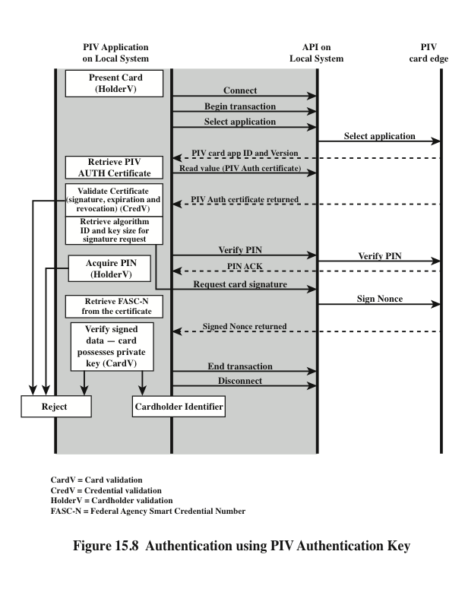
Notes:
A variety of protocols can be constructed for each of these authentication
types. SP-800-78-3 gives examples for each type. Figure 15.8 illustrates an authentication
scenario that includes the use of the PIV Authentication Key. This scenario
provides a high level of assurance. This scenario would be appropriate for authentication
of a user who possesses a PIV card and seeks access to a computer resource.
The computer, designated local system in the figure, includes PIV application
software
and communicates to the card via an application program interface that
enables the use of relatively high-level procedure calls. These high-level commands
are converted into PIV commands that are issued to the card through a physical
interface via a card reader or via a wireless interface. In either case, SP-800-73 refers
to the card command interface as the PIV card edge.
The scenario of Figure 15.8 accomplishes three types of authentication. The
combination of possession of the card and knowledge of the PIN service authenticates
the cardholder. The PIV Authentication Key certificate validates the card’s
credentials. The challenge-response protocol authenticates the card.

Slide 23
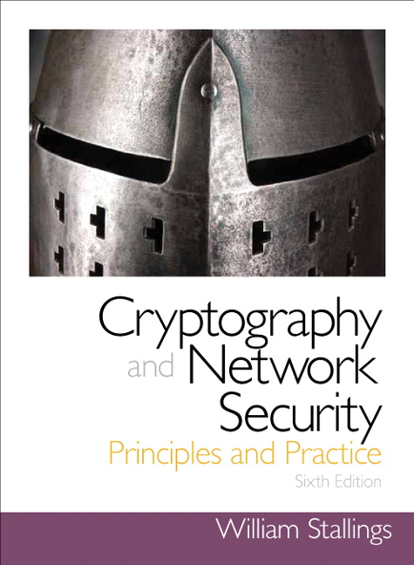
Summary
Remote user-authentication principles
Mutual authentication
One-way authentication
Remote user-authentication using symmetric encryption
Mutual authentication
One-way authentication
Kerberos
Motivation
Kerberos V4 and V5
Remote user-authentication using asymmetric encryption
Mutual authentication
One-way authentication
Federated identity management
Identity management
Identity federation
Personal identity verification
PIV system model
PIV documentation
PIV credentials and keys
authentication
Notes:
Chapter 15 summary.

